Slide 1
Diffie-Hellman Key Exchange / Agreement Algorithm

Slide 2
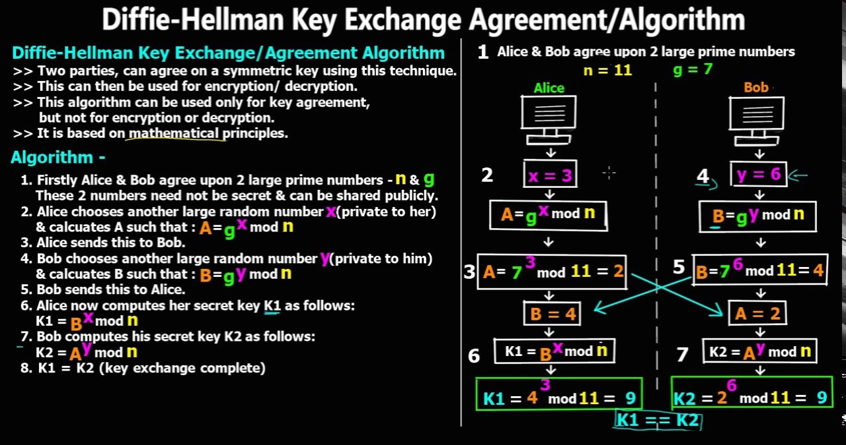

Slide 3
Mathematical Theory Behind The Diffie-Hellman Algorithm
Alice computes ----
K1 = B^{X} mod n ………………… (i) [Ref. step 6 of slide2]
Replacing B = g^{Y} mod n [Ref. step 4 of slide2] in equation (i) we get,
K1 = (g^{Y} mod n)^{X} mod n = (g^{Y})^{X} mod n = g^{XY} mod n … (ii)
Bob computes ----
K2 = A^{Y} mod n ………………… (iii) [Ref. step 7 of slide2]
Replacing A = g^{X} mod n [Ref. step 2 of slide2] in equation (iii) we get,
K2 = (g^{X} mod n)^{Y} mod n = (g^{X})^{Y} mod n = g^{xy} mod n … (iv)
Hence, from equation (ii) and (iii) we can say, K1 = K2 = K is the shared symmetric key.

Slide 4
Man-in-the-middle Attack
Step 1:
Alice
n=11, g=7
Bob
n=11, g=7
Tom
n=11, g=7

Slide 5
Man-in-the-middle Attack
Step 2:
Alice
x=3
Bob
y=9
Tom
x=8, y=6

Slide 6
Man-in-the-middle Attack
Step 3:
Step 4:
Alice
A = g^{X} mod n
=7³ mod 11
=2
Bob
B = g^{y} mod n
=7⁹ mod 11
=8
Tom
A = g^{X} mod n
=7⁸ mod 11
=9
B = g^{y} mod n
=7⁶ mod 11
=4
Alice
A=2, B=4
Bob
A=9, B=8
Tom
A=2, B=8

Slide 7
Man-in-the-middle Attack
Step 5:
Alice
K1 = B^{X} mod n
=4³ mod 11
=9
Bob
K2 = A^{y} mod n
=9⁹ mod 11
=5
Tom
K1 = B^{X} mod n
=8⁸ mod 11
=5
K2 = A^{y} mod n
=2⁶ mod 11
=9

Slide 8
Thank You

